Slide 1
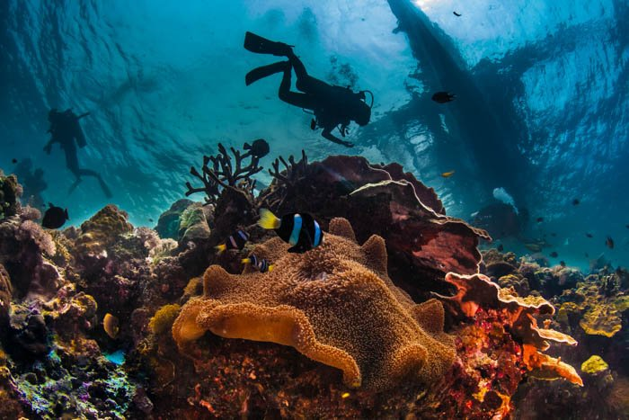
Project Boyang’s Fish
Progress Check 1: Michael Tsui - Engineer
Oscar Liu – Programmer
Andy Meng – Graphic Designer & Financial Manager
Boyang Zhao – Team Mascot

Slide 2
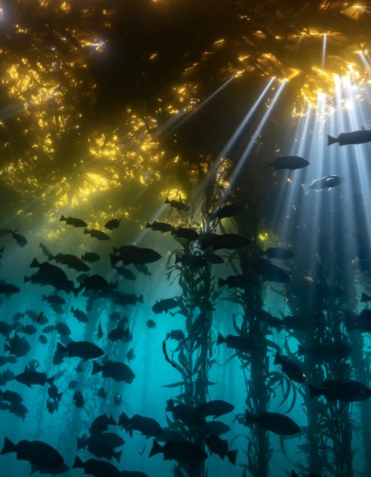
Our Purpose
-To create innovative technology for probing and searching the depths.
-Inspired to discover new marine life and possible anomalies

Slide 3
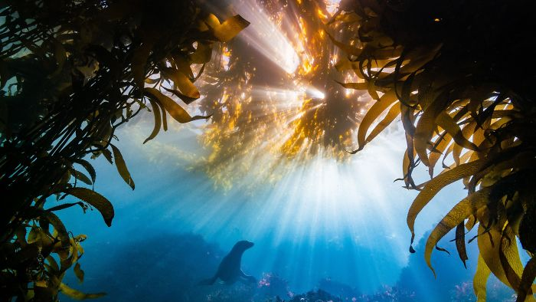
Progress

Slide 4
Folder Link and Documentation
https://github.com/NoOneofConsequencePrime/Boyang-s-Fish

Slide 5
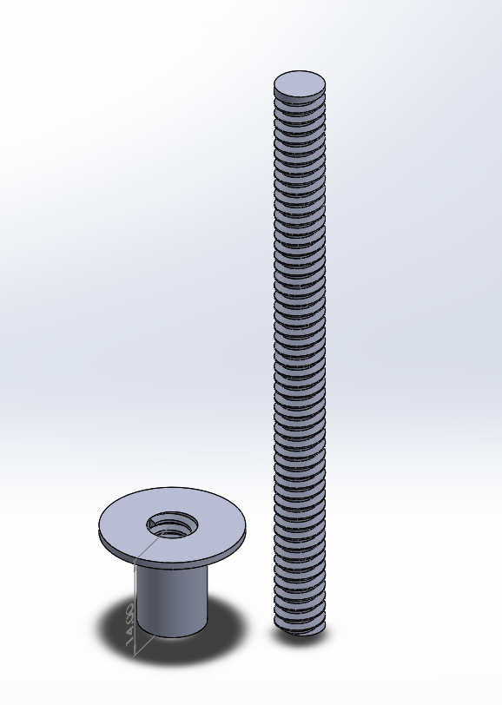
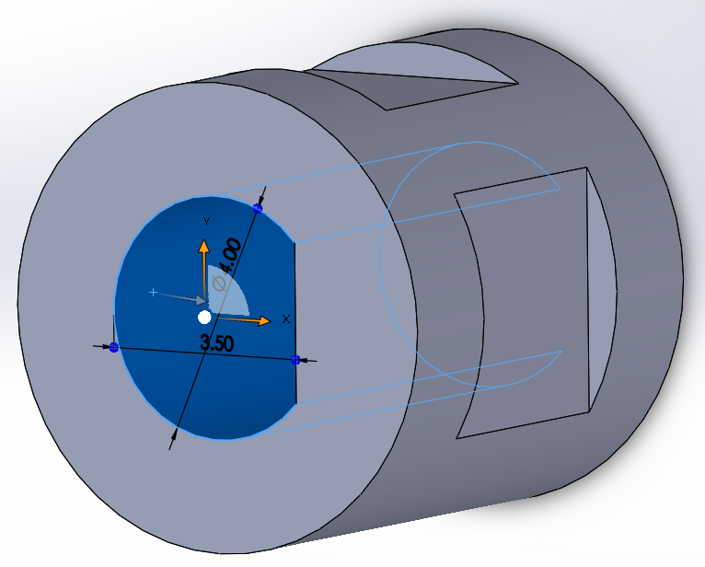
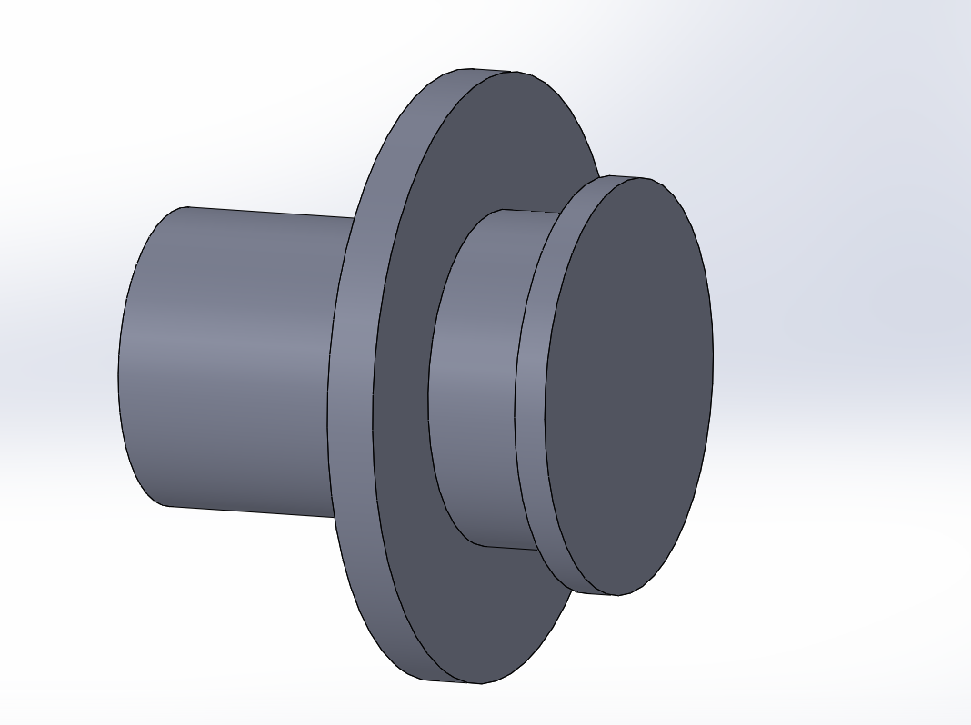
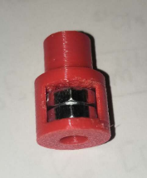
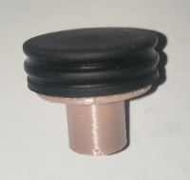
Purchased Parts
3D prints
All parts are tested
Parts fit
Motor shaft adapter
Syringe Base
Syringe Hold cover

Slide 6
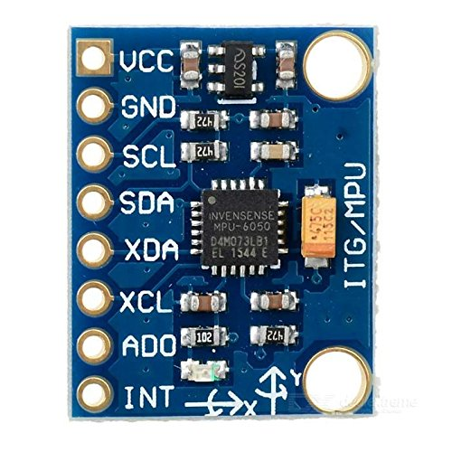
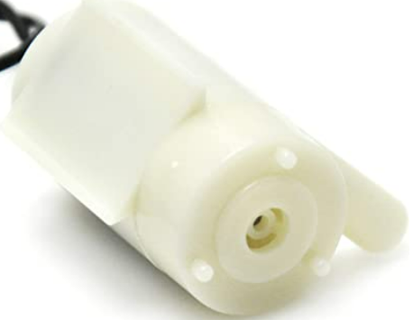
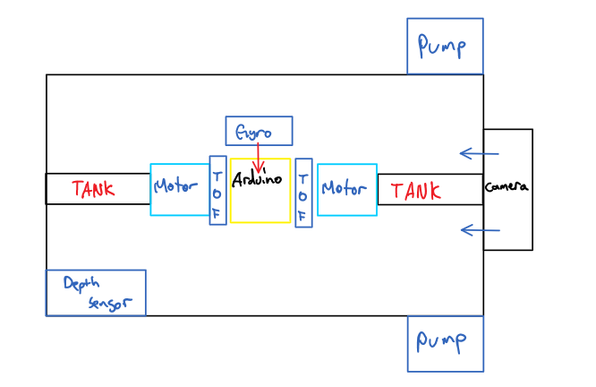
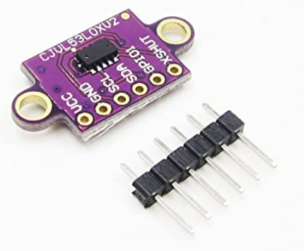
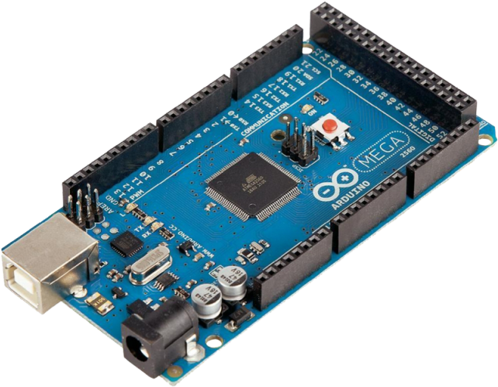
Design & Sketch

Slide 7
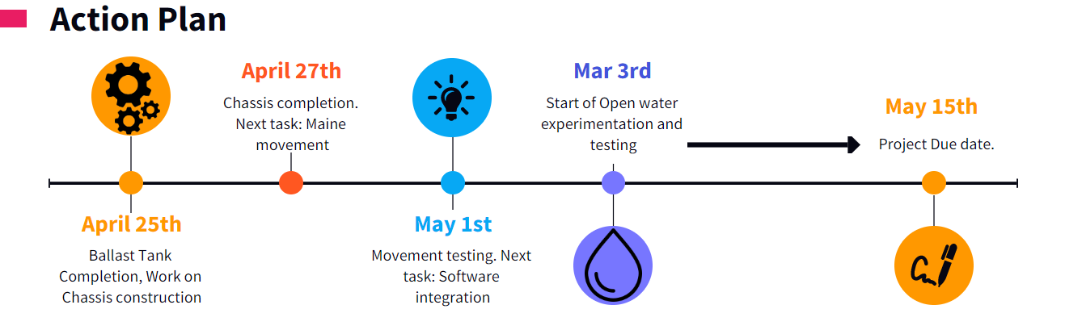
Revised Timeline

Slide 8
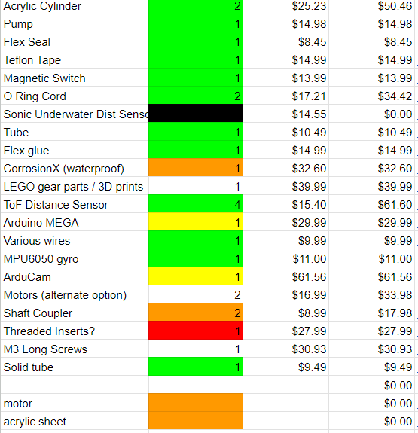


Revised Budget Plan

Slide 9
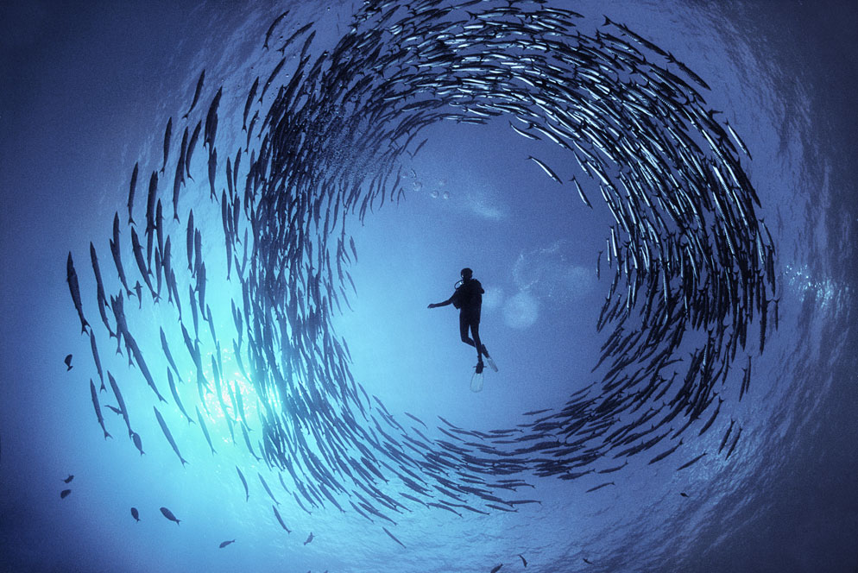
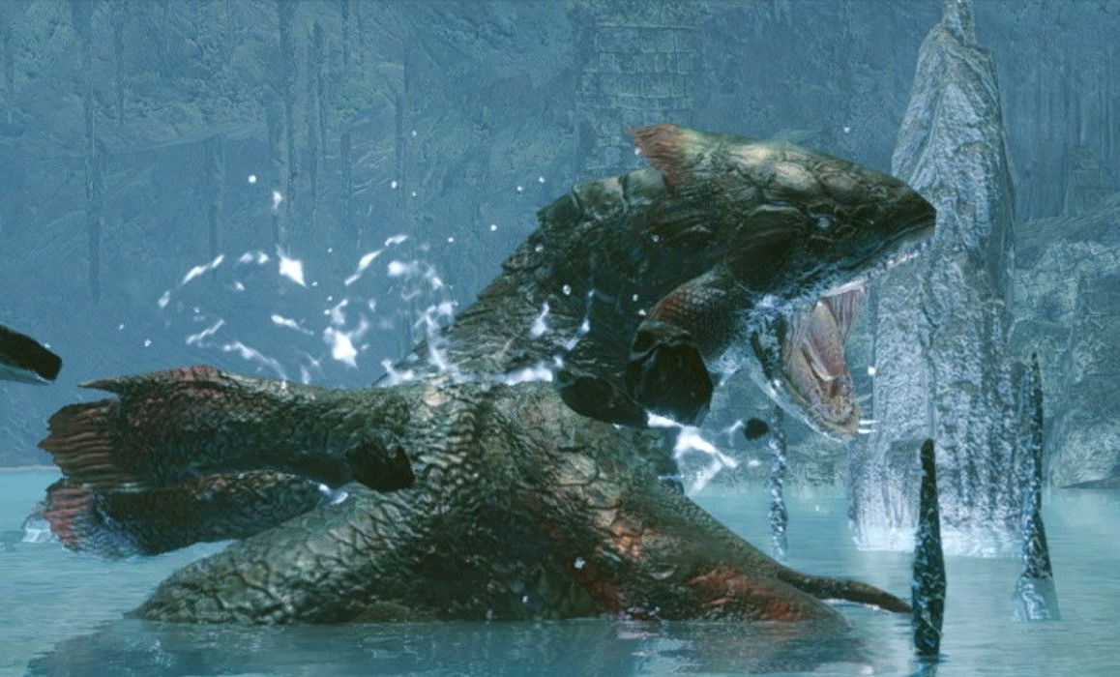
Issues to be Addressed
Problem 1: 3D print material
Problem 2: Printer uncertainty
Solution:
- Use linear gear track OR
- Use metal threads instead

Slide 10

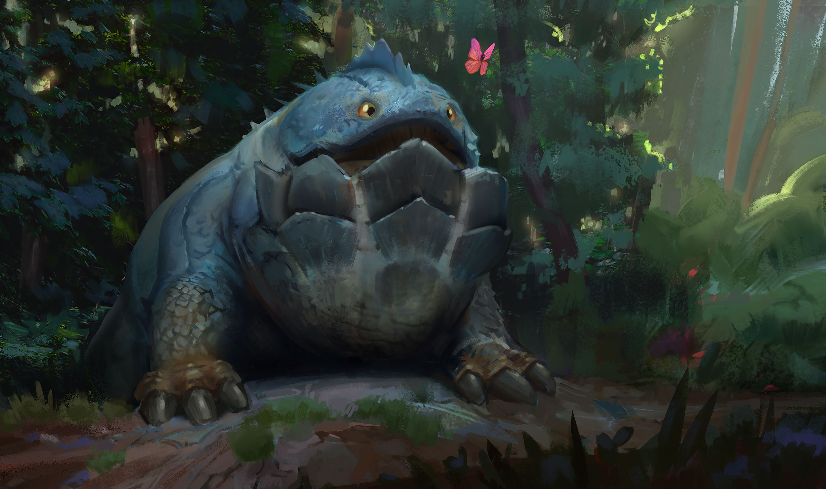
THANK YOU
Contact us:
Bryan.zhao@sac.on.ca
Michael.tsui@sac.on.ca
Andy.meng@sac.on.ca
Oscar.liu@sac.on.ca

